Slide 1


Dawit Getinet
october 6, 2024 G.C

Slide 2

Outline
Executive Summary
Introduction
Methodology
Results
Conclusion
Appendix

Slide 3
Executive Summary
Summary of methodologies
Data collection
Data wrangling
EDA with data visualization
EDA with SQL
Building an interactive map
Building a Dashboard
Predictive analysis
Summary of all results
Exploratory data analysis results
Interactive analytics demo in screenshots
Predictive analysis results

Slide 4
Introduction
Project background and context
SpaceX's reusable Falcon 9 first stage significantly reduces launch costs, priced at $62 million compared to competitors' $165 million or more. Predicting the successful landing of the first stage is crucial for determining the overall cost of a launch. This information can be valuable for potential competitors seeking to bid against SpaceX, allowing them to accurately assess launch costs and develop competitive pricing strategies.
Problems you want to find answers
What factors determine the success of a rocket landing?
Understanding how different rocket variables influence the success rate of a Falcon 9 first stage landing is crucial.
Reveal the specific conditions SpaceX must achieve to maximize landing success.
By optimizing these variables, SpaceX can ensure a higher probability of successful landings and further reduce launch costs

Slide 5

Section 1

Slide 6
Methodology
Executive Summary
data collection: Collect data using SpaceX REST API and web scraping techniques
Wrangle data: by filtering the data, handling missing values and applying
one hot encoding to prepare the data for analysis and modeling
Explore data via EDA with SQL and data visualization techniques
Visualize the data using Folium and Plotly Dash
Build Models to predict landing outcomes using classification models. Tune
and evaluate models to find best model and paramete

Slide 7
Data Collection
Request data from SpaceX API
Decode response using .json() and convert to a dataframe using .json_normalize()
Request information about the launches from SpaceX API using custom functions
Create dictionary from the data
Create dataframe from the dictionary
Filter dataframe to contain only Falcon 9 launches
Replace missing values of Payload Mass with calculated .mean()
Export data to csv file

Slide 8
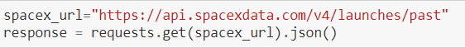
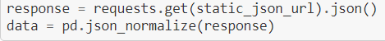
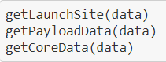
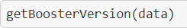
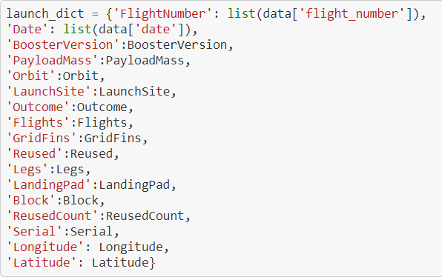
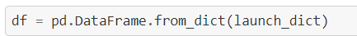
1 .Getting Response from API
Data collection – SpaceX API
2. Converting Response to a .json file
3. Apply custom functions to clean data
flow chart
4. Assign list to dictionary then dataframe
Normalize data into flat data file such as .csv
5. Filter dataframe and export to flat file (.csv)

Slide 9
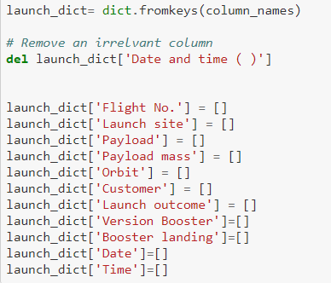
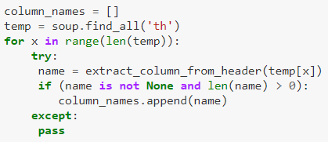
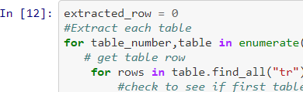
1 .Getting Response from HTML
simplified flow chart
5. Creation of dictionary
2. Creating BeautifulSoup Object
3. Finding tables
4. Getting column names
Data collection – Web
scraping
Appending data to keys (refer) to notebook block 12
Converting dictionary to dataframe
Normalize data into flat data file such as .csv
8. Dataframe to .CSV

Slide 10
Data Wrangling
Steps Landing Outcome Cont.
Perform EDA and determine data labels
Calculate:
number of launches for each site
number and occurrence of orbit
number and occurrence of mission
outcome per orbit type]
Create binary landing outcome
column (dependent variable)
Export data to csv file
False Ocean: represented an unsuccessful landing to a specific region of ocean
True RTLS: meant the mission had a successful landing on a ground pad
False RTLS: represented an unsuccessful landing on a ground pad
True ASDS: meant the mission outcome had a successful landing on a drone ship
False ASDS: represented an unsuccessful landing on drone ship
Outcomes converted into 1 for a successful landing and 0 for an unsuccessful landing
Landing Outcome
Landing was not always successful
True Ocean: mission outcome had a successful landing to a specific region of the ocean

Slide 11



EDA with data visualization
Scatter Graphs being drawn:
Flight Number VS. Payload Mass Flight Number VS. Launch Site Payload VS. Launch Site
Orbit VS. Flight Number Payload VS. Orbit Type Orbit VS. Payload Mass
Scatter plots show how much one variable is affected by another. The relationship between two variables is called their correlation . Scatter plots usually consist of a large body of data.
Bar Graph being drawn:
Mean VS. Orbit
A bar diagram makes it easy to compare sets of data between different groups at a glance. The graph represents categories on one axis and a discrete value in the other. The goal is to show the relationship between the two axes. Bar charts can also show big changes in data over time.
Line Graph being drawn:
Success Rate VS. Year
Line graphs are useful in that they show data variables and trends very clearly and can help to make predictions about the results of data not yet recorded

Slide 12
EDA with SQL
Queries
Display:
Names of unique launch sites
5 records where launch site begins with ‘CCA’
Total payload mass carried by boosters launched by NASA (CRS)
Average payload mass carried by booster version F9 v1.1.
List:
Date of first successful landing on ground pad
Names of boosters which had success landing on drone ship and have
payload mass greater than 4,000 but less than 6,000
Total number of successful and failed missions
Names of booster versions which have carried the max payload
Failed landing outcomes on drone ship, their booster version and launch site for the months in the year 2015
Count of landing outcomes between 2010-06-04 and 2017-03-20 (desc)

Slide 13
Map with Folium
Markers Indicating Launch Sites
Added blue circle at NASA Johnson Space Center's coordinate with a
popup label showing its name using its latitude and longitude coordinates
Added red circles at all launch sites coordinates with a popup label
showing its name using its name using its latitude and longitude coordinates
Colored Markers of Launch Outcomes
Added colored markers of successful (green) and unsuccessful (red) launches at each launch site to show which launch sites have high success rates
Distances Between a Launch Site to Proximities
Added colored lines to show distance between launch site CCAFS SLC- 40 and its proximity to the nearest coastline, railway, highway, and city

Slide 14
Dashboard with Plotly Dash
Dropdown List with Launch Sites
Allow user to select all launch sites or a certain launch site
Pie Chart Showing Successful Launches
Allow user to see successful and unsuccessful launches as a percent of the total
Slider of Payload Mass Range
Allow user to select payload mass range
Scatter Chart Showing Payload Mass vs. Success Rate by Booster Version
Allow user to see the correlation between Payload and Launch Success

Slide 15
Predictive Analytics
Charts
Create NumPy array from the Class column
Standardize the data with StandardScaler. Fit and transform the data.
Split the data using train_test_split
Create a GridSearchCV object with cv=10 for parameter optimization
Apply GridSearchCV on different algorithms: logistic regression (LogisticRegression()), support vector machine (SVC()), decision tree (DecisionTreeClassifier()), K-Nearest Neighbor (KNeighborsClassifier())
Calculate accuracy on the test data using .score() for all models
Assess the confusion matrix for all models
Identify the best model using Jaccard_Score, F1_Score and Accuracy

Slide 16
Results
Exploratory data analysis results
Interactive analytics demo in screenshots
Predictive analysis results

Slide 17
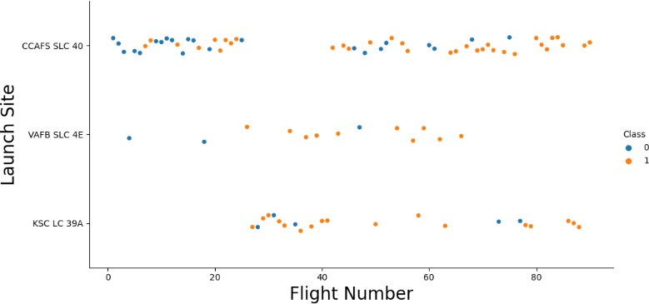
Flight Number vs. Launch Site
Exploratory Data Analysis
Earlier flights had a lower success rate (blue = fail)
Later flights had a higher success rate (orange = success)
Around half of launches were from CCAFS SLC 40 launch site
VAFB SLC 4E and KSC LC 39A have higher success rates
We can infer that new launches have a higher success rate

Slide 18
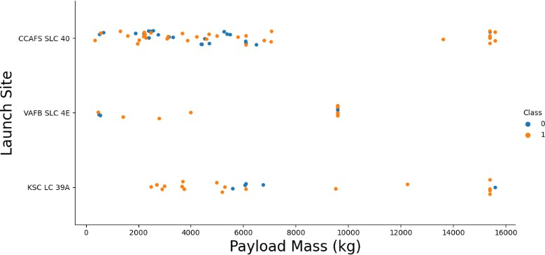
Payload vs. Launch Site
Exploratory Data Analysis
Typically, the higher the payload mass (kg), the higher the success rate
Most launces with a payload greater than 7,000 kg were successful
KSC LC 39A has a 100% success rate for launches less than 5,500 kg
VAFB SKC 4E has not launched anything greater than ~10,000 kg
Class 0 = Fail Class 1 = Success

Slide 19
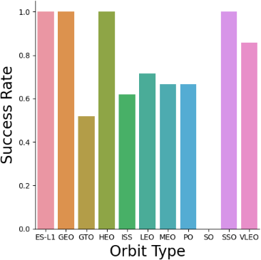
Success Rate by Orbit
Exploratory Data Analysis
100% Success Rate: ES-L1, GEO, HEO and SSO
50%-80% Success Rate: GTO, ISS, LEO, MEO, PO
0% Success Rate: SO

Slide 20
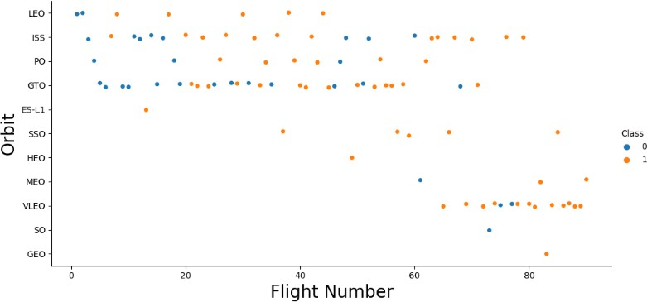
Flight Number vs. Orbit
Exploratory Data Analysis
The success rate typically increases with the number of flights for each orbit
This relationship is highly apparent for the LEO orbit
The GTO orbit, however, does not follow this trend
Class 0 = Fail Class 1 = Success

Slide 21
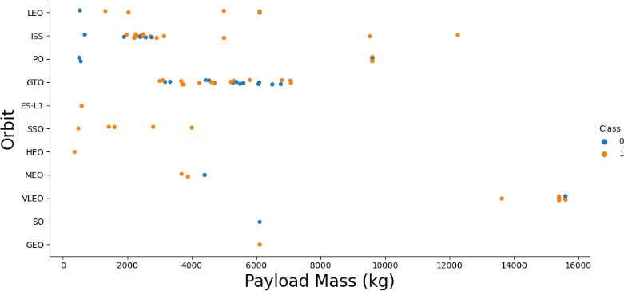
Payload vs. Orbit
Exploratory Data Analysis
Heavy payloads are better with LEO, ISS and PO orbits
The GTO orbit has mixed success with heavier payloads
Class 0 = Fail Class 1 = Success

Slide 22
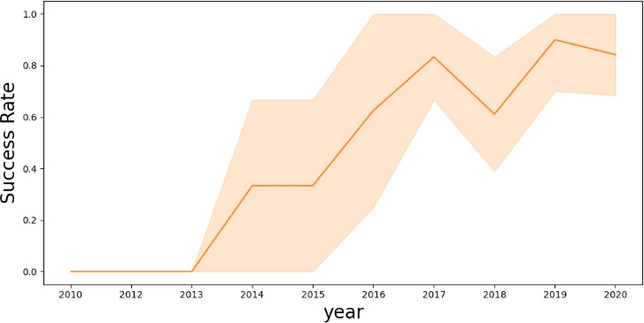
Launch Success over Time
Exploratory Data Analysis
The success rate improved from 2013-2017 and 2018-2019
The success rate decreased from 2017-2018 and from 2019-2020
Overall, the success rate has improved since 2013

Slide 23
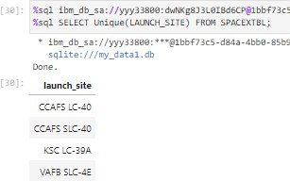
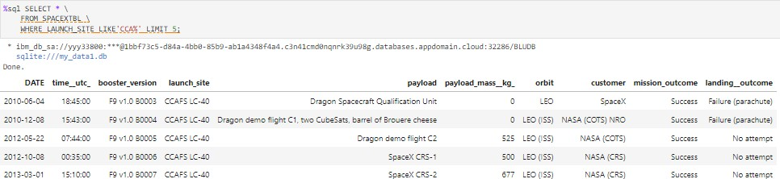
Launch Site Information
Launch Site Names Landing Outcome Cont.
CCAFS LC-40
CCAFS SLC-40
KSC LC-39A
VAFB SLC-4E
Records with Launch Site Starting with CCA
Displaying 5 records below

Slide 24
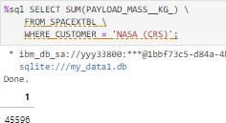
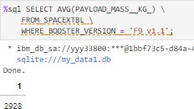
Payload Mass
Total Payload Mass
Average Payload Mass
45,596 kg (total) carried by boosters launched by NASA (CRS)
2,928 kg (average) carried by booster version F9 v1.1

Slide 25
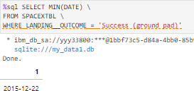
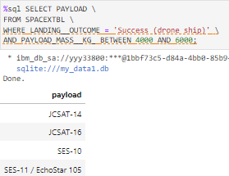
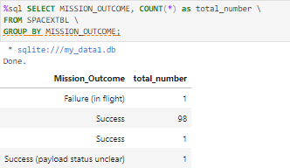
Landing & Mission Info
1st Successful Landing in Ground Pad Booster Drone Ship Landing
12/22/2015
Booster mass greater than 4,000 but less than 6,000
JSCAT-14, JSCAT-16, SES-10, SES-11 / EchoStar 105
Total Number of Successful and Failed Mission Outcomes
1 Failure in Flight
99 Success
1 Success (payload status unclear)

Slide 26
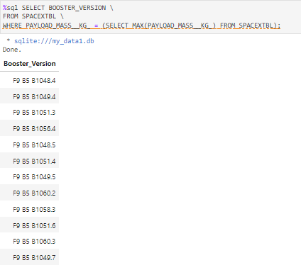
Boosters
Carrying Max Payload
F9 B5 B1048.4
F9 B5 B1049.4
F9 B5 B1051.3
F9 B5 B1056.4
F9 B5 B1048.5
F9 B5 B1051.4
F9 B5 B1049.5
F9 B5 B1060.2
F9 B5 B1058.3
F9 B5 B1051.6
F9 B5 B1060.3
F9 B5 B1049.7

Slide 27
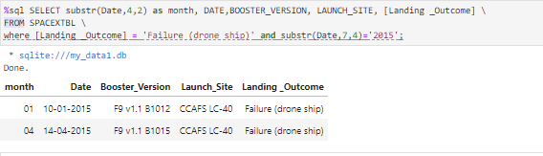
Failed Landings on Drone Ship
In 2015
Showing month, date, booster version, launch site and landing outcome

Slide 28
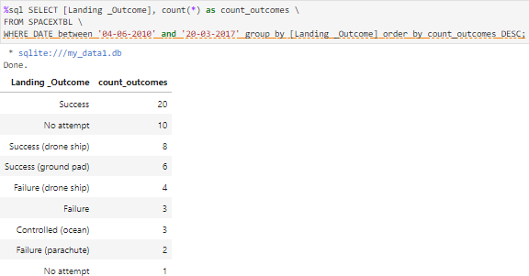
Count of Successful Landings
Ranked Descending
Count of landing outcomes between 2010-06-04 and 2017-03-20 in descending order

Slide 29

Section 3

Slide 30
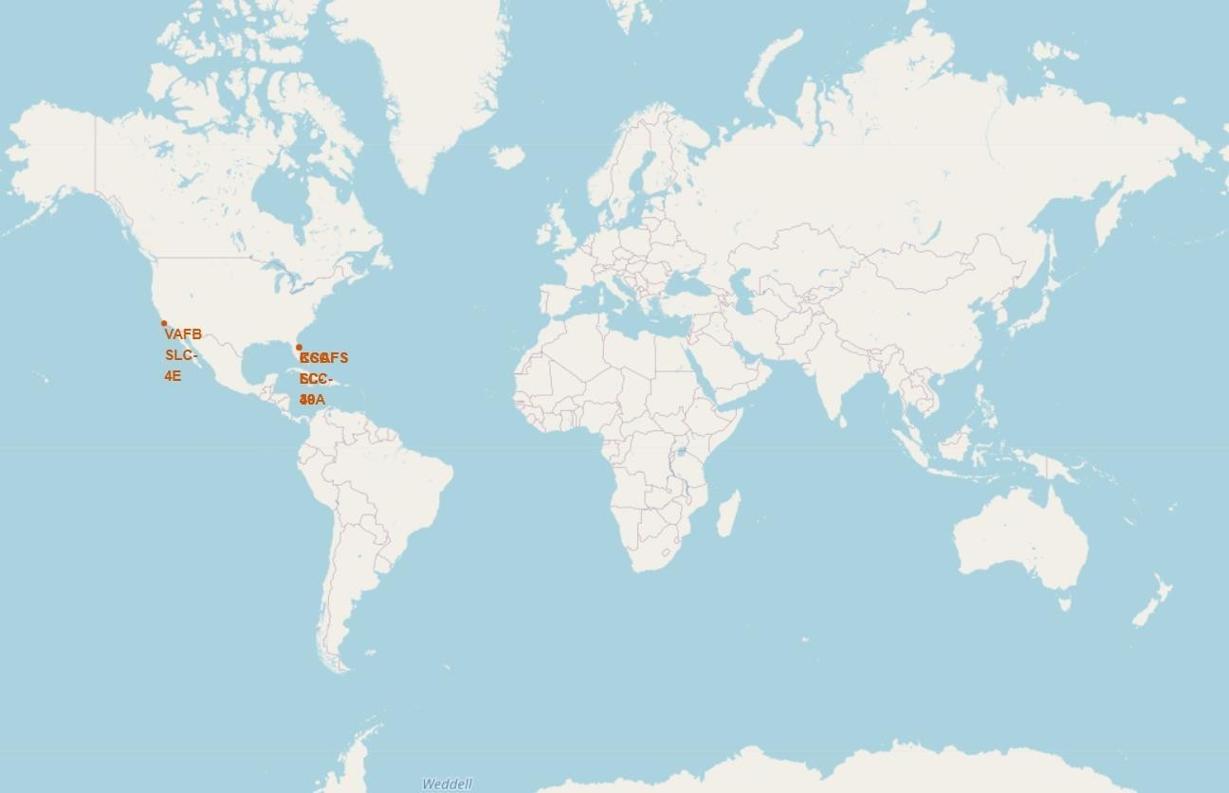
All launch sites global map markers
We can see that the SpaceX launch sites are in the United States of America coasts. Florida and California

Slide 31
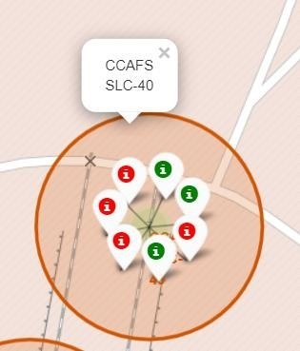
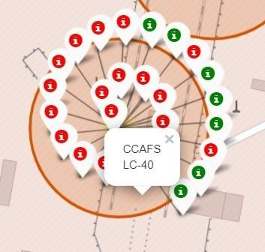
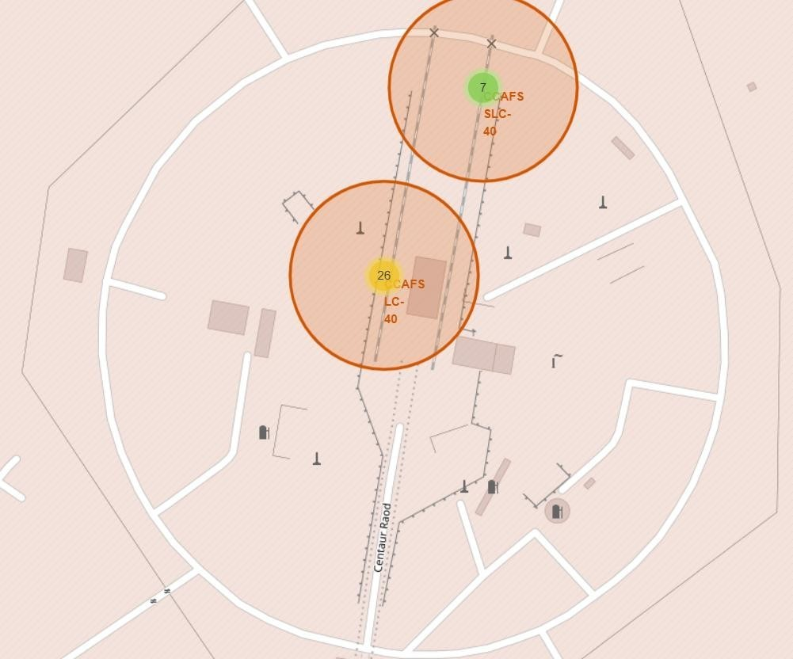
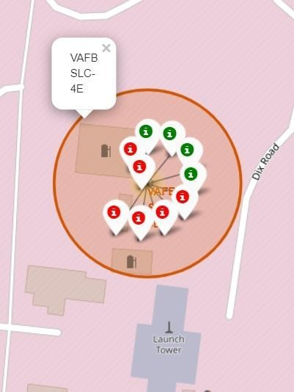
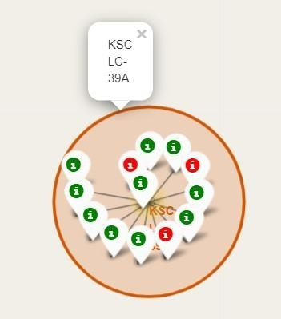
Colour Labelled Markers
California Launch Site
37
Florida Launch Sites
Green Marker shows successful Launches and Red Marker shows Failures

Slide 32
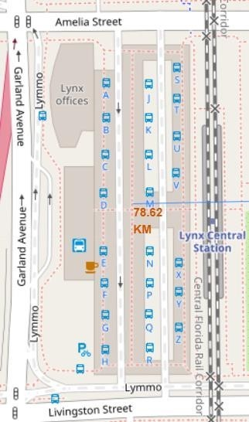
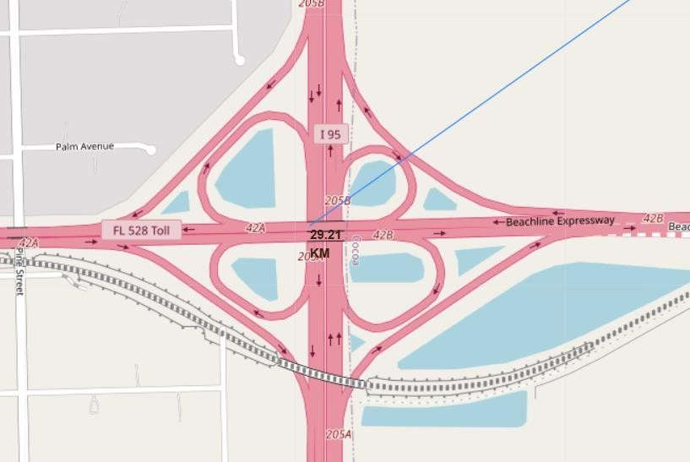
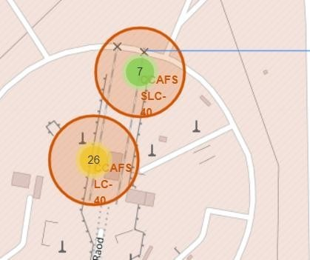
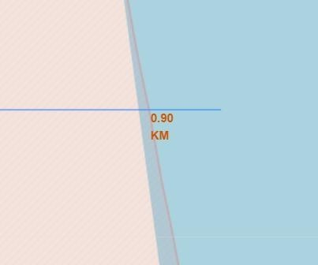
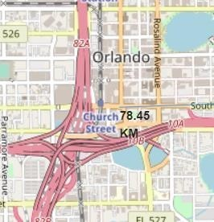
Working out Launch Sites distance to landmarks to find trends with Haversine formula using CCAFS-SLC-40 as a reference
Distance to closest Highway
Distance to coast
Are launch sites in close proximity to railways? No
Are launch sites in close proximity to highways? No
Are launch sites in close proximity to coastline? Yes
Do launch sites keep certain distance
away from cities? Yes
Distance to Railway Station
Distance to Coastline
Distance to City

Slide 33
Dashboard with Plotly Dash
Section 4:

Slide 34
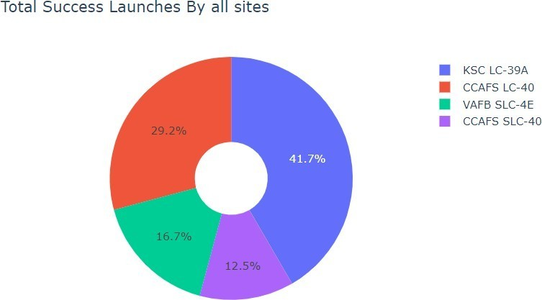
DASHBOARD – Pie chart showing the success percentage achieved by each launch site
We can see that KSC LC-39A had the
most successful launches from all the sites

Slide 35
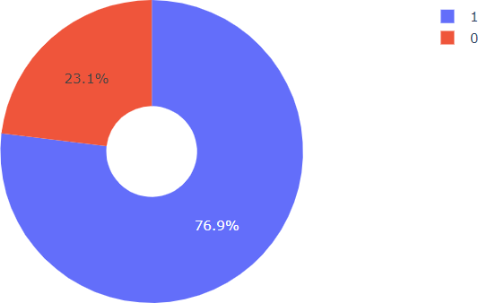
DASHBOARD – Pie chart for the launch site with highest launch success ratio
KSC LC-39A achieved a 76.9% success rate while geFng a 23.1% failure rate

Slide 36
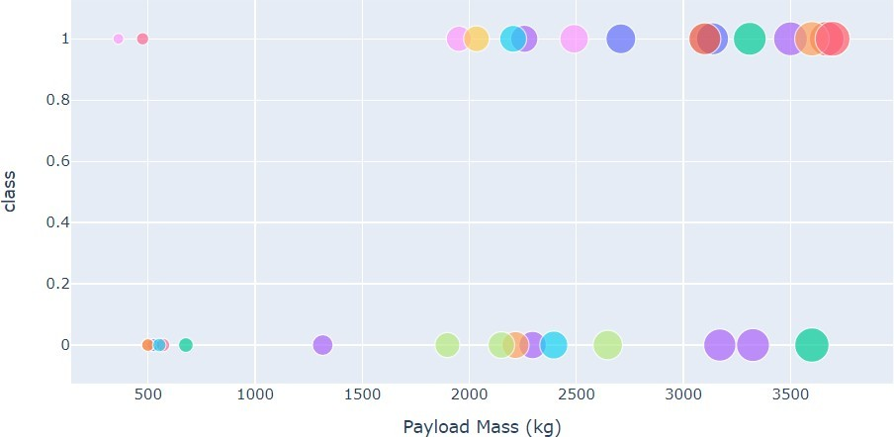
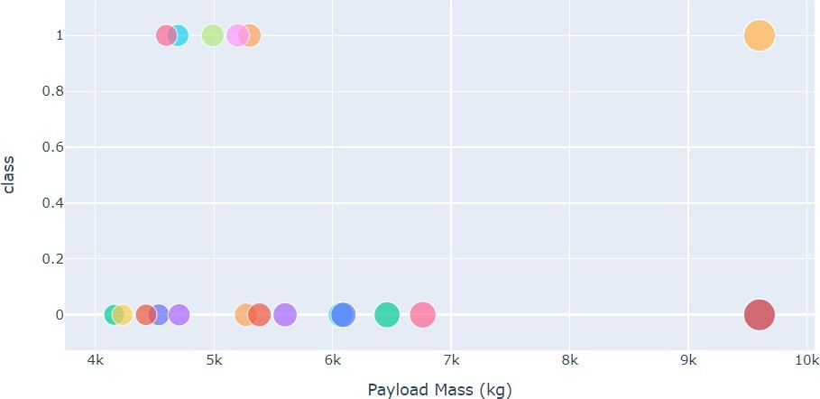
DASHBOARD – Payload vs. Launch Outcome scatter plot for all sites, with different payload selected in the range slider
Low Weighted Payload 0kg – 4000kg
Heavy Weighted Payload 4000kg – 10000kg
We can see the success rates for low weighted payloads is higher than the heavy weighted payloads

Slide 37

Section 5

Slide 38
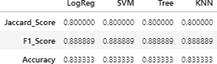
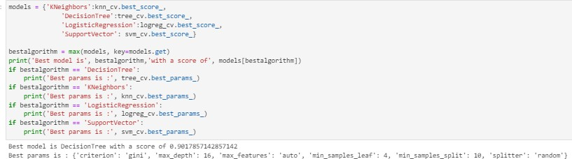
Classification
Accuracy
All the models performed at about the same level and had the same scores and accuracy. This is likely due to the small dataset. The Decision Tree model slightly outperformed the rest when looking at .best_score

Slide 39
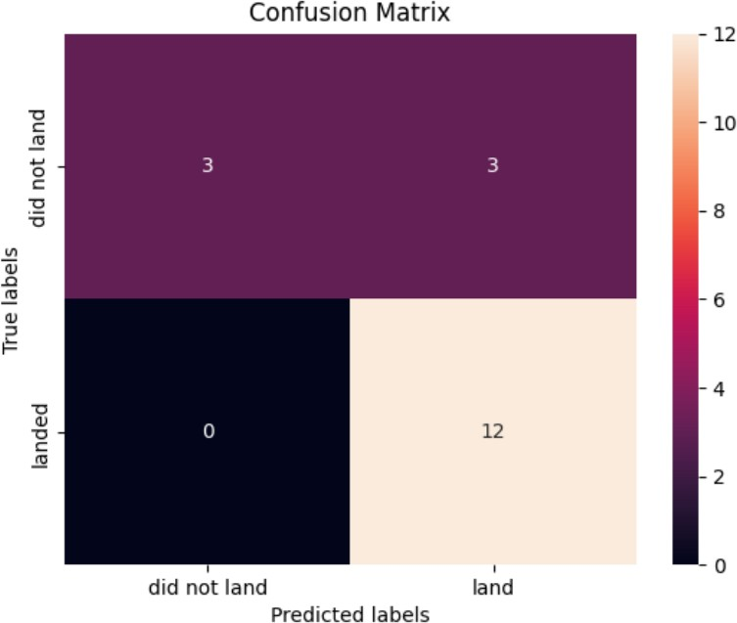
Confusion Matrices
Performance Summary
A confusion matrix summarizes the performance of a classification algorithm
All the confusion matrices were identical
The fact that there are false positives (Type 1 error) is not good
Confusion Matrix Outputs:
12 True positive
3 True negative
3 False positive
0 False Negative
Precision = TP / (TP + FP)
12 / 15 = .80
Recall = TP / (TP + FN)
12 / 12 = 1
F1 Score = 2 * (Precision * Recall) / (Precision + Recall)
2 * (.8 * 1) / (.8 + 1) = .89
Accuracy = (TP + TN) / (TP + TN + FP + FN) = .833

Slide 40
Conclusion
Research
Model Performance: The models performed similarly on the test set with the decision tree model slightly outperforming
Equator: Most of the launch sites are near the equator for an additional natural boost - due to the rotational speed of earth - which helps save the cost of putting in extra fuel and boosters
Coast: All the launch sites are close to the coast
Launch Success: Increases over time
KSC LC-39A: Has the highest success rate among launch sites. Has a 100% success rate for launches less than 5,500 kg
Orbits: ES-L1, GEO, HEO, and SSO have a 100% success rate
Payload Mass: Across all launch sites, the higher the payload mass (kg), the higher the success rate

Slide 41


